Slide 1

The Accused
The murder mystery game designed for undergraduate labs with dichotomous keying
By: Shuxiao Zhang
Last updated Sep. 10, 2023

Slide 2



Directions
This slide deck is meant to both served as basic template of the game for the instructor and provide directions for instructor and students.
Slides to be deleted by the instructor before presenting to the students are marked with a red bar on top. Text to be replaced / deleted are in [square brackets].

Slide 3
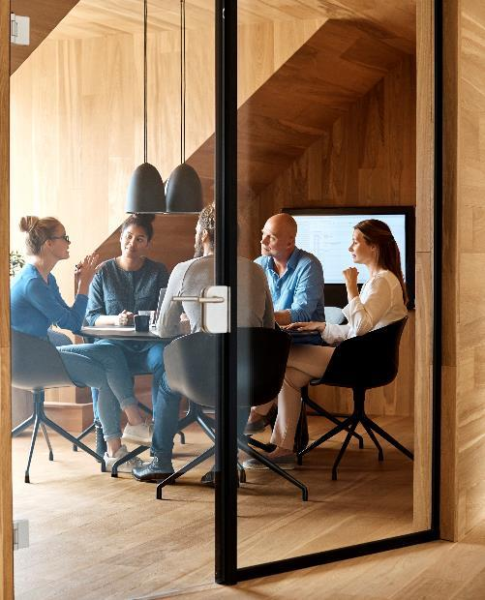



Class set up
Length of game depends on how long it takes to perform the classroom activities – i.e. if it takes more than one lab to obtain the traits needed for identification / dichotomous keying it will be a multi-lab game
Player limit: 5-25 players per game. I.e. If it is a large class please divide into size typically used for a discussion section.

Slide 4
Directions: IF THIS ISN’T A LAB CLASS
i.e. you can still use this game to make students memorize different traits / terms even for a traditional lecture-based class
Divide this game into multiple sessions of 5-10min activity done at the end of class or as homework:
Day 1: sign up for location (slide 9)
Day 2: reveal sample is found at crime scene, list of suspects BUT ONLY PROVIDE THE FIRST TRAIT of dichotomous keying
Day 3+: each day provide 1 more trait needed to ID the sample
3rd to last day: student vote
2nd to last day: the defendant speaks
Last day: final vote + verdict

Slide 5
Game set up: start with the answer key
Make a list of the final number of samples that the students (players) will have to key / identify.
Keep this list for yourself, do NOT share with class
Sample number | Sample | Student
1 | Red maple wood section
2 | Pine
3 | Sycamore
4 | Walnut
5 | Poplar
If you have more students than samples, you may need to add additional “clues” based on the map (slide 7) or personal preference to help narrow down the suspect. If samples > students then each sample number & map location can contain more than 1 samples (e.g. sample number 1 on Garfield St can contain both red maple AND poplar).

Slide 6
Set up the dichotomous key
ESSENTIAL
Optional
Randomly pick one of the samples from slide 5 to be the sample discovered at the crime scene
Write the key. The dichotomous key WILL be shared with students
Write up a list of traits needed to identify the sample in the dichotomous key
Students can vote during the length of the game or vote for the “verdict” at the end of the game as a “jury” depending on if this is a lecture-based class or lab class
Adding in additional “hints” for traits that may be associated with the traits of interest as additional “clues” or provide additional storytelling elements can make the class more engaging

Slide 7
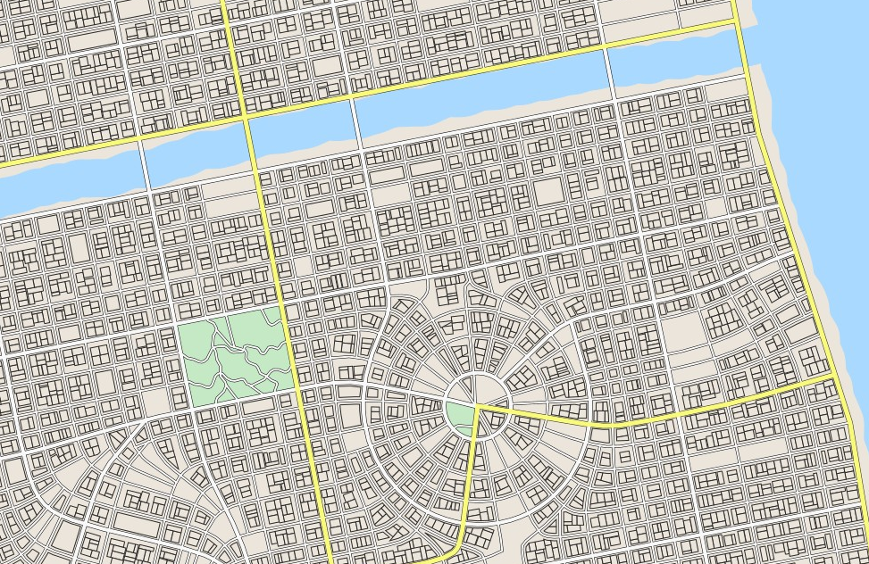
Game set up: instructor set up the map
Find a map / generate your own using the free app: https://maps.probabletrain.com/#/
1
Randomly pick sites on map where your samples named in slide 5 are located. The number of samples must match the number of sites, e.g.:
Site 1 = red maple
2 = pine
3 = sycamore
4 = walnut
5 = poplar
2
4
3
5

Slide 8
Game set up: set up the map
Find a map / generate your own using the free app: https://maps.probabletrain.com/#/
1
Randomly pick a location for the crime scene
During class have students sign up for the sites (see next slide)
Remember to copy and paste the student list also into slide #12 & 14.
2
3
4
Crime Scene
5

Slide 9
You are a student at Oceanview College located in St. Hildegard
The college is located 3 blocks south of the area shown in the map.
Sign up for one of the apartment locations indicated in the map:
1
2
Location | Student Name
442 Garfield St. #4
3280 Riverview St.
23 Garden Rd. Unit B.
115 Walnut Ln. #2
673 Leckie St. #16
4
3
5

Slide 10

A crime has occurred
Last week, a sophomore student from Oceanview College (your school) has been reported as missing. Following investigation by the SHPD, the missing student was found deceased in their apartment. At the crime scene the police discovered an unusual sample that is suspected to come from the murderer….

Slide 11
You are a student at Oceanview College located in St. Hildegard
1
The crime scene is located at 371 South Garfield St., Unit C.
The sample traits are described by the SHPD as:
[list the traits described in slide #6, for the sample you picked for the murderer]
2
4
3
Crime Scene
5

Slide 12
List of suspects
The police have identified the following list of suspects and potential identify of the sample found at the crime scene
Sample number | Sample ID | Student name
442 Garfield St. #4 | Red maple
3280 Riverview St. | Pine
23 Garden Rd. Unit B. | Sycamore
115 Walnut Ln. #2 | Walnut
673 Leckie St. #16 | Poplar
[If there is excess time / done as out of class assignment / the class size is small, the students can be asked to write up / say a short sentence defending themselves (i.e. say why they’re innocent)]

Slide 13

Let the investigation begin:
[paste dichotomous key from slide 6 here]

Slide 14
You are a student at Oceanview College located in St. Hildegard
1
Based on your investigation, who do you think is guilty?
[can vote by raising hand / setting up a poll]
2
Location | Student Name
442 Garfield St. #4
3280 Riverview St.
23 Garden Rd. Unit B.
115 Walnut Ln. #2
673 Leckie St. #16
4
3
Crime Scene
5

Slide 15

The defense
This is the time to ask if any one of the student want to speak up to accuse / defense anyone / themselves. The student must provide a reason for their defense / accusation.

Slide 16
The defendant
Does the defendant have anything to say?
Any anyone have anything to say in defense?
Does anyone want to add anything to the prosecution side?

Slide 17


The final verdict
Have the students vote again. This vote will decide the final verdict.
Use this opportunity to highlight the applicability / importance of dichotomous keying, the traits covered, and critical thinking
Provide encouragement to students (dichotomous keying requires lots of positive feedback)
Summarize any major discoveries / mistakes the students made when they worked together as a group

Slide 18
The final verdict
Any questions?

